Slide 1
DATA 824 HW7: Kansas County Geographical Mapping
Created by Chad Huntebrinker on 10/16/2025

Slide 2
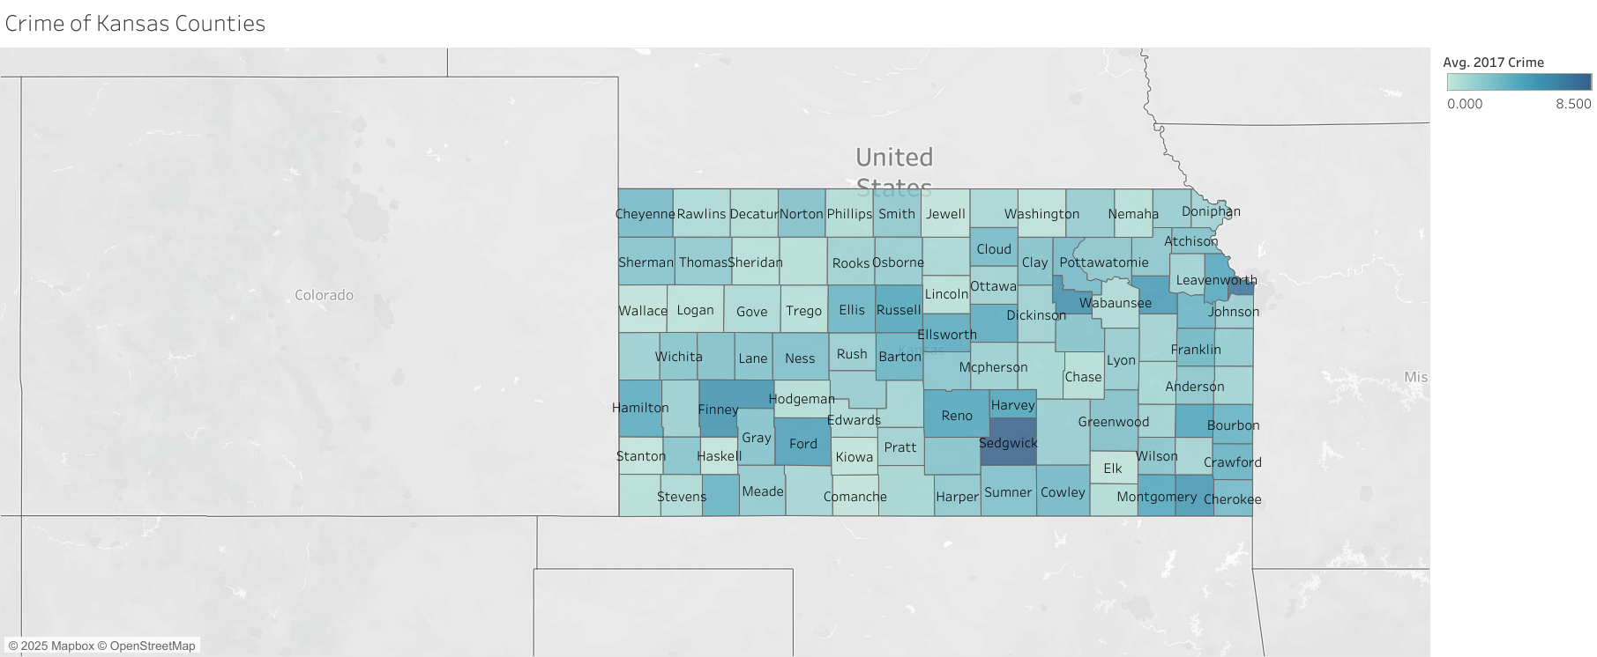
Check to see if there is some sort of correlation between crime rates and population. Looks like Sedgwick has a high crime rate.

Slide 3
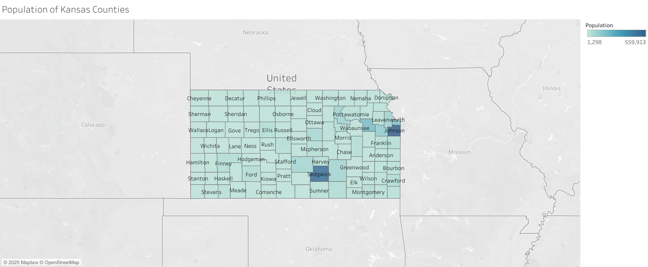
There might be a slight correlation, as Sedgwick and Johnson county are our two most populated counties but Sedwick has a higher crime rate compared to other counties. However, Johnson county has a lower crime rate.

